Slide 1

Visualization of Simulated T-cell migration within a heterogenous Tumor
By Tony Zhang

Slide 2
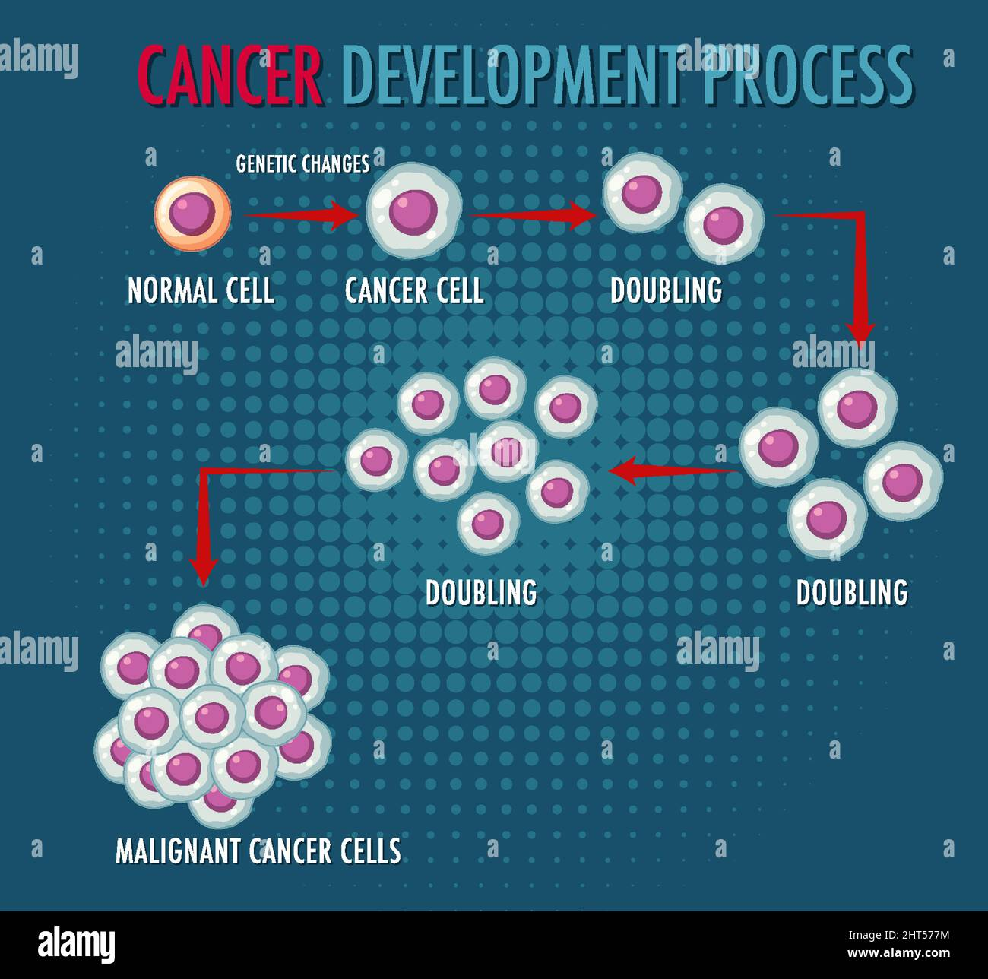
How Tumors Develop
Genetic Mutation Occurs.
Mutation disables growth regulator.
Cells divide uncontrollably.
Benign Tumor Forms.
Angiogenesis.
Malignancy.

Slide 3
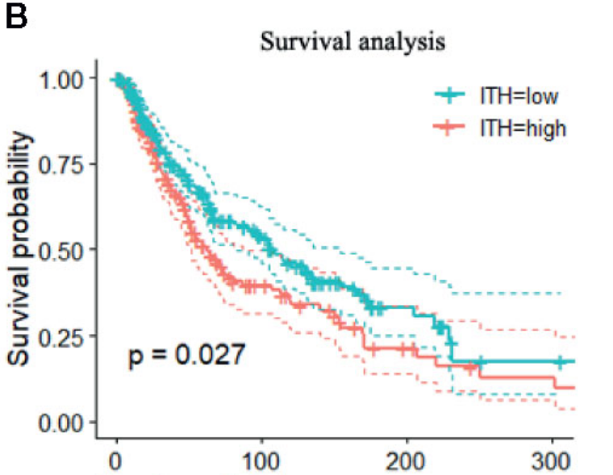
Intratumor Heterogeneity (ITH)
During uncontrollable growth, daughter cells acquire new mutations.
Daughter cells also replicate with their mutation.
Results in a tumor which is a patchwork of different subpopulations with distinct mutations.
The MATH score quantifies intratumor heterogeneity by measuring the variability in mutant allele frequencies within a tumor; higher scores indicate greater genetic diversity among cancer cells. It is calculated as 100 × (median absolute deviation / median) of the mutant allele frequencies. (Mroz & Rocco, 2013, Nat Genet)

Slide 4
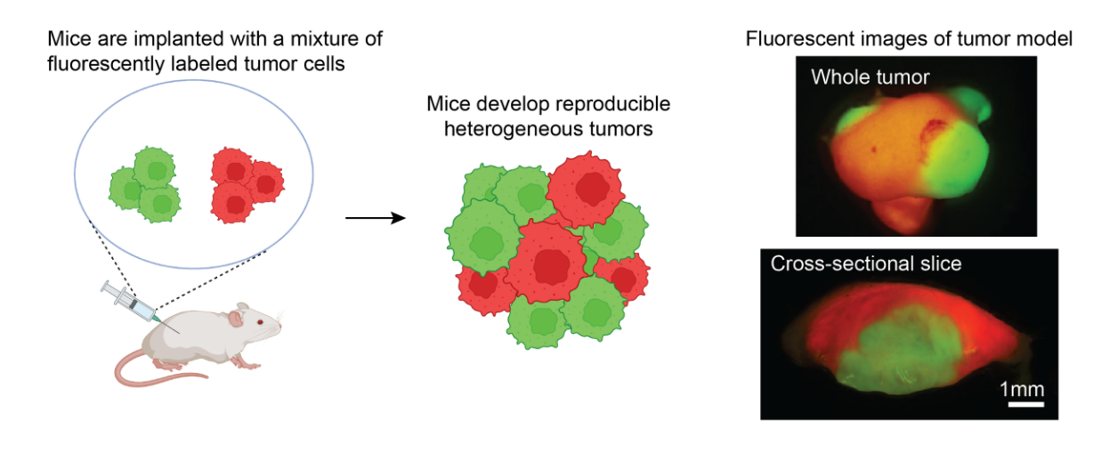
Reeve’s Lab
Located at the Huntsman Cancer Institute.
Developed a novel mouse model to investigate ITH.
Mixes two skin cancer cell lines.

Slide 5
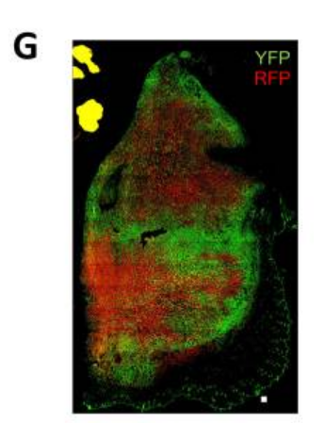
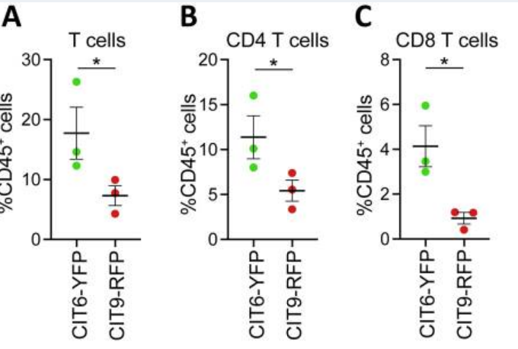
Findings
Immune “hot” and immune “cold”
T cells localize in “hot” region.
“cold” region recruits macrophages which suppress T cell activity.
Immune “hot” and “hotter” populations.
T cells would only localize in one region.
Unsure as to the reason
Cross section of “hot” (YFP) and “cold” (RFP) tumor. As well as T cell counts in each region. (Tanaka et. al, 2023)

Slide 6
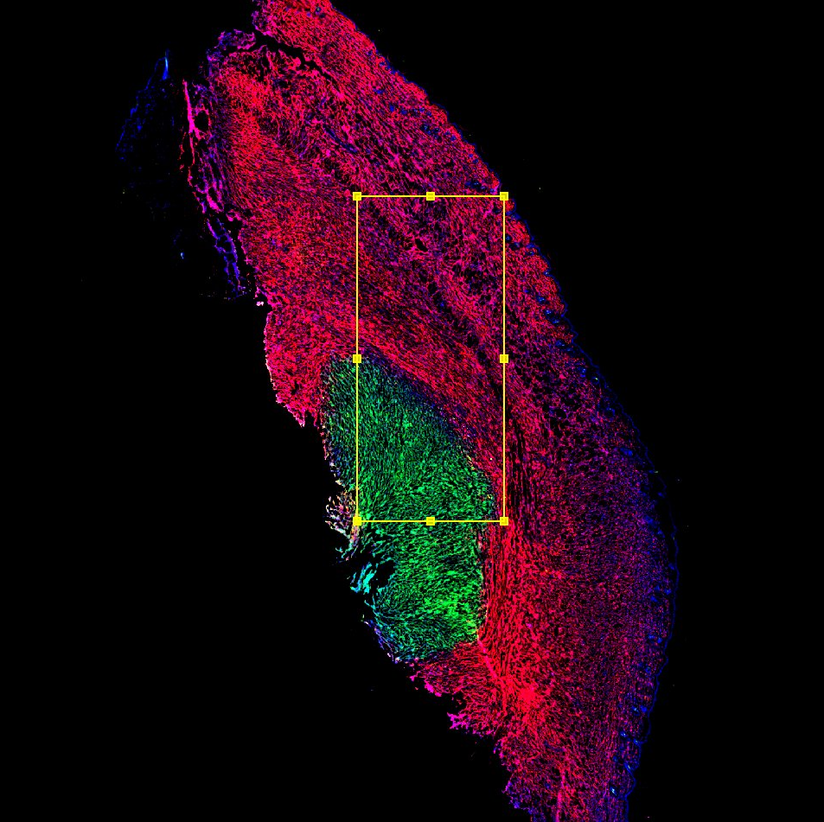
Chemokine Gradient?
Chemokine – Chemotactic Cytokine.
Cells can “smell” them and move towards them.
Can this explain localization of T-cells in two “hot” populations model?

Slide 7
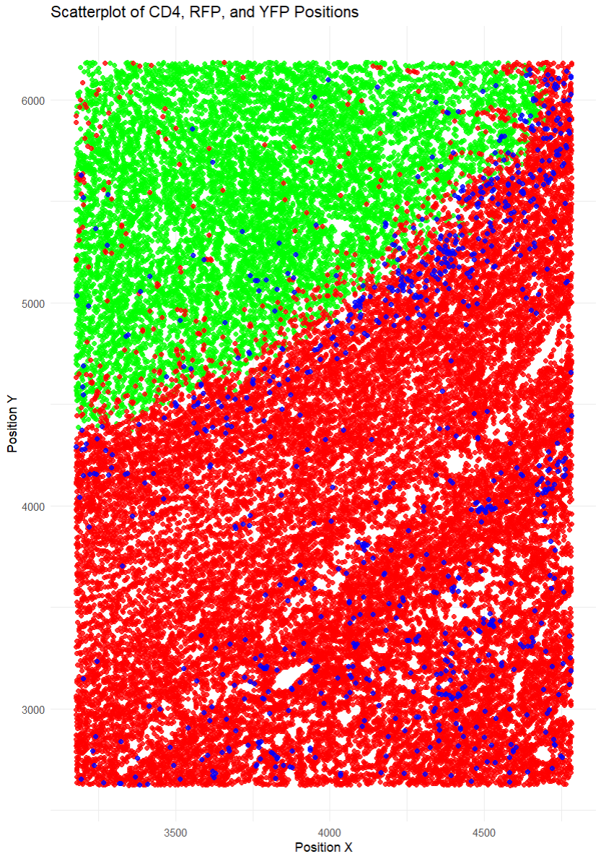
Method
Clean up dataset.
Chemokine gradient:
2D diffusion steady state equation.
Use diffusion and decay constants of potential chemokines.
Vary production amounts.
Simulated T cell migration:
Randomly scatter initial positions.
Move in direction of greatest chemokines concentration.
Sample Circular Normal (Von Mises) Distribution.
Higher Kappa results in following the gradient more closely

Slide 8
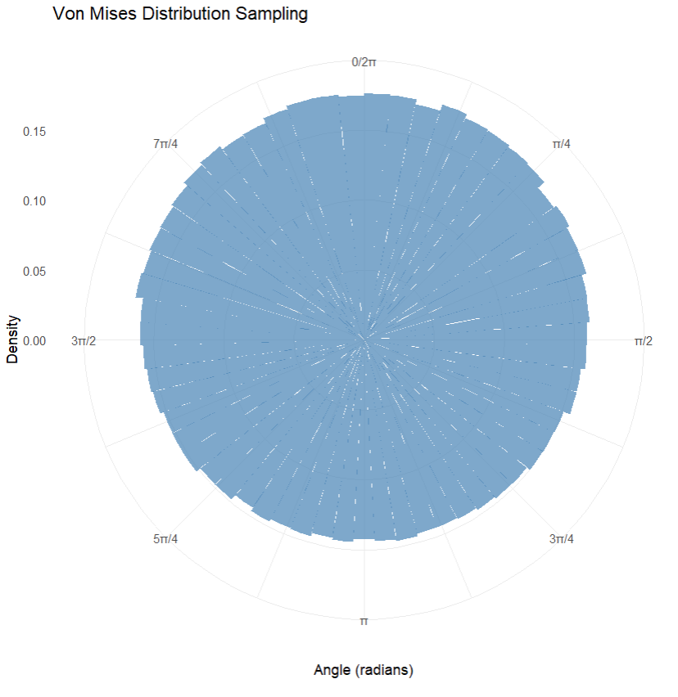
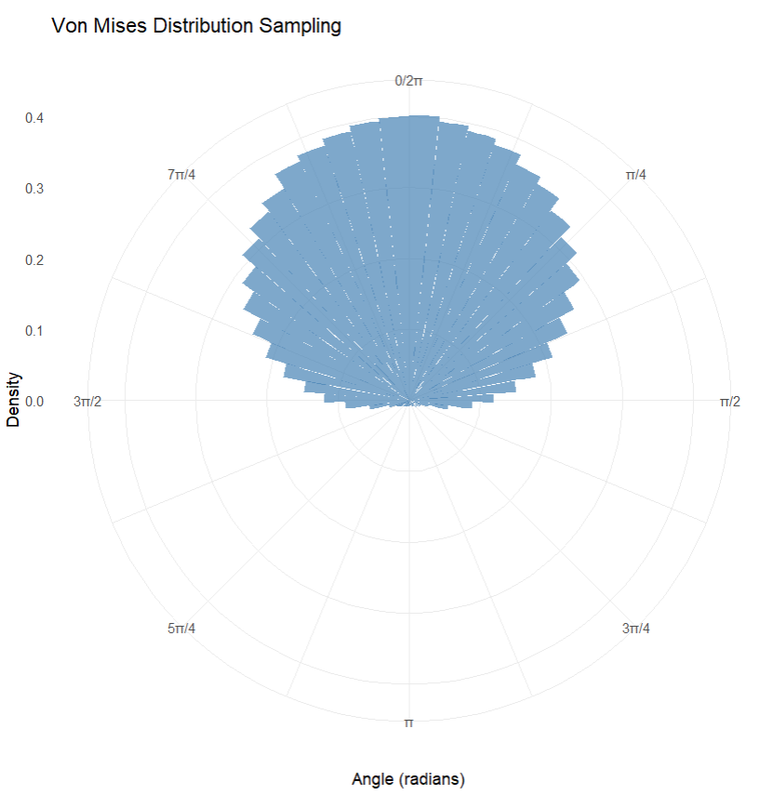
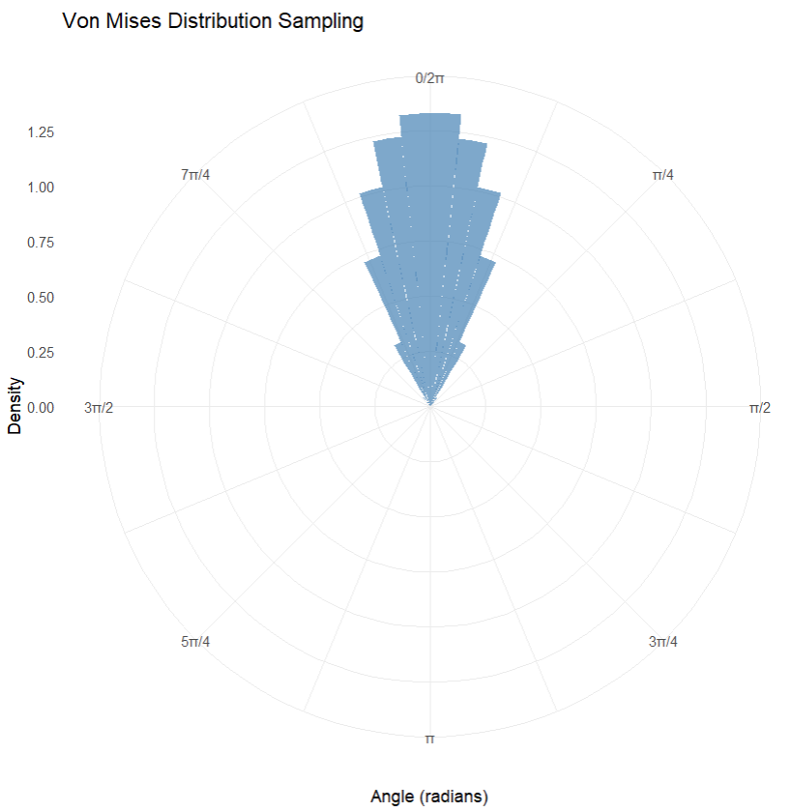
Visualization Approach
Line Integral Convolution of chemokine gradient.
Height Encoded concentration amount.
Overlay T cell movement animation with path lines.
Try with different kappas: (0.1, 1, 10)
Kappa indicates the chemokine sensitivity for each T cell

Slide 9
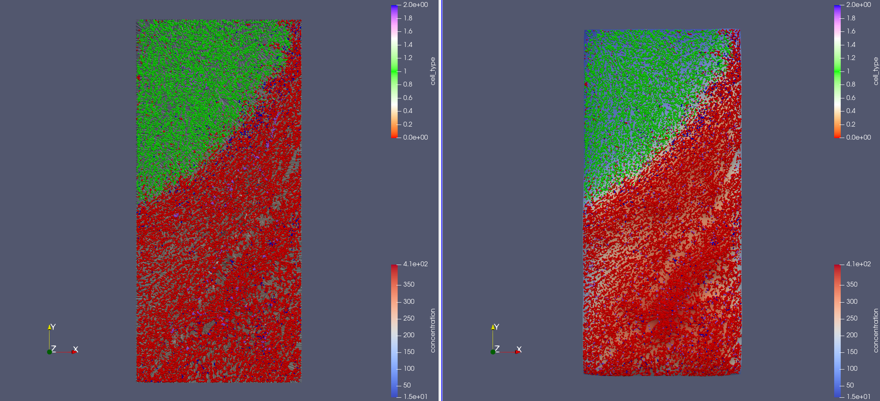
Results

Slide 10
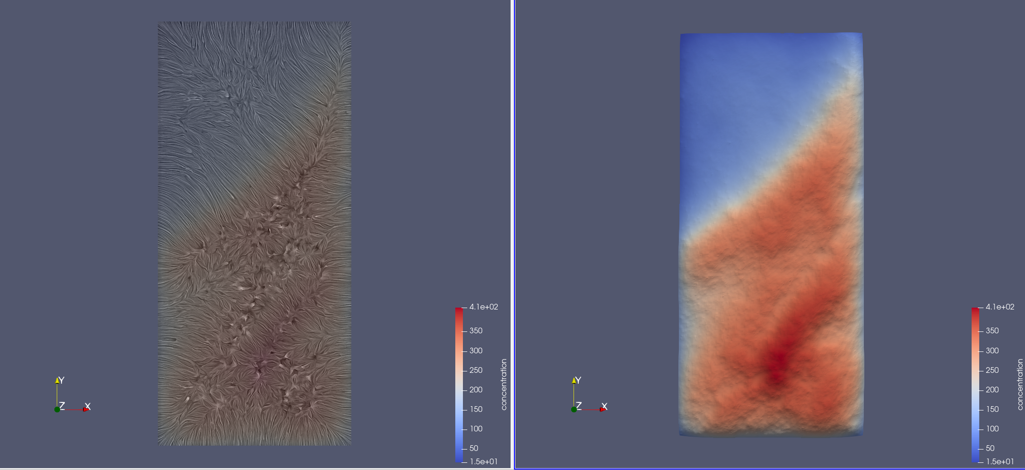
Results

Slide 11
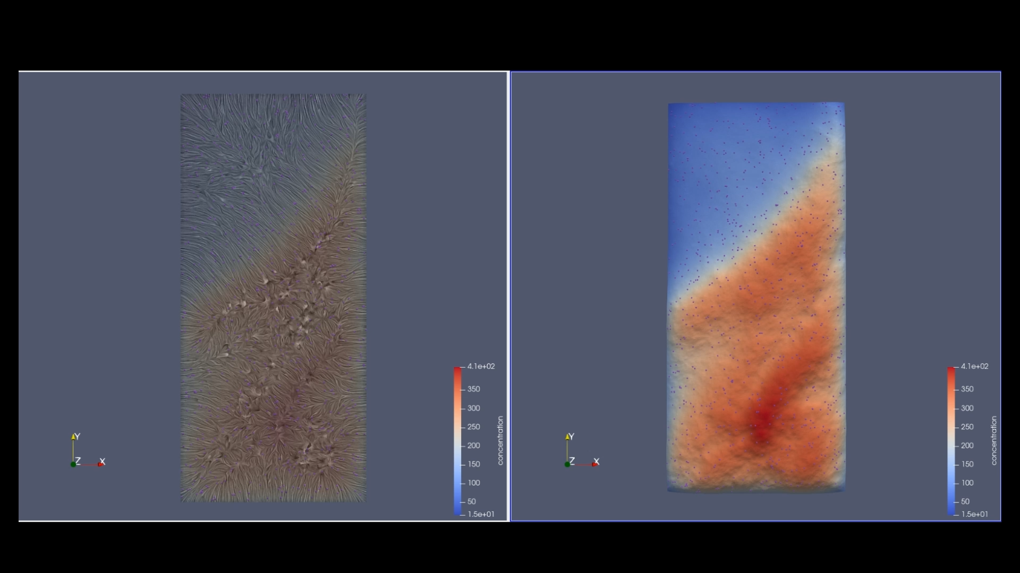
Results

Slide 12
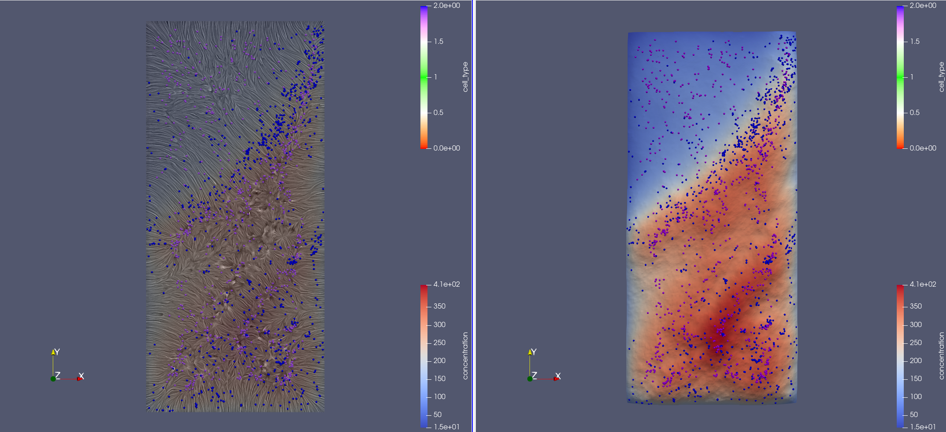
Results

Slide 13
Conclusion
Visualization is useful to verify that my code worked as expected.
Much easier to interpret the model visually than thinking about numbers.
Can’t really tell if the model replicated the positions accurately (statistical method would probably be better).
Future work could include more mechanisms such as tumor growth, immune cells killing tumors cells, etc.

Slide 14
Acknowledgements
Dr. Fred Adler
Montana Ferita
The Reeve’s Lab
UROP

Slide 15
Questions?

